Slide 1
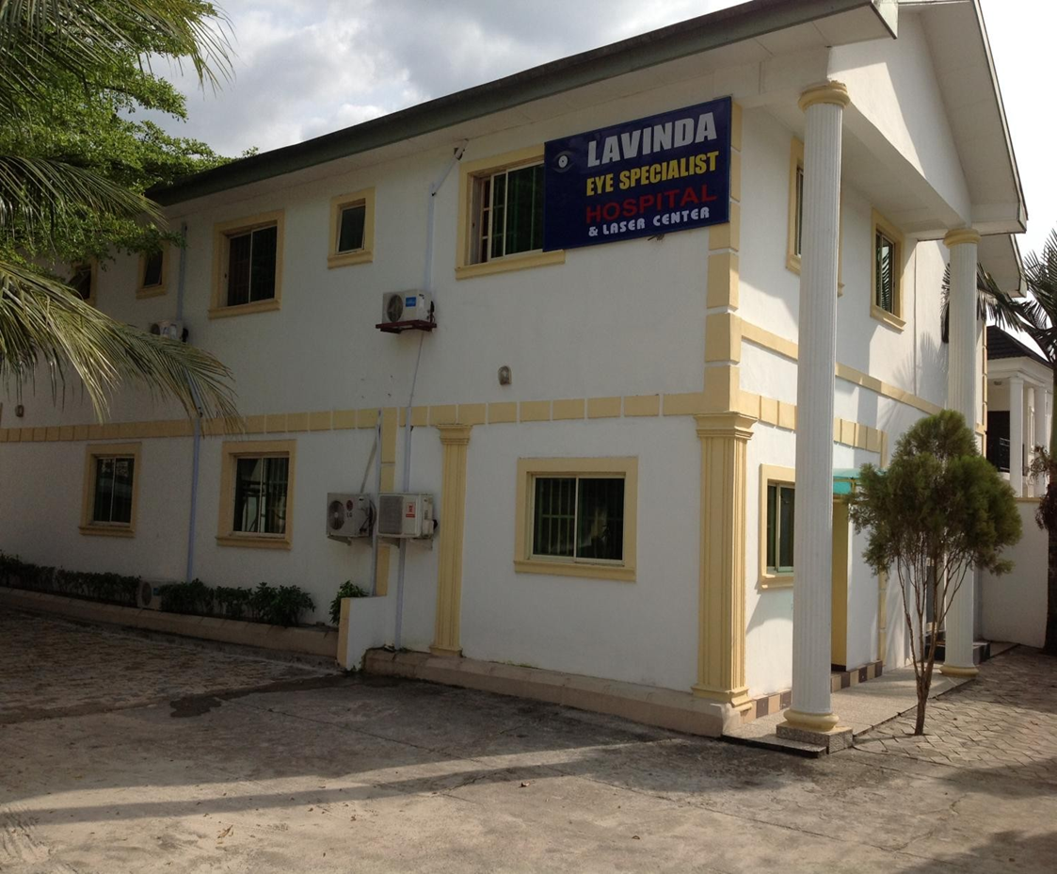
Individual Consultancy Project Assignment Lavinda Eye Specialist Hospital
Presented by:
Notes:
Hello everyone. Thank you for joining me today. My presentation focuses on a consultancy project I conducted with Lavinda Eye Specialist Hospital, a healthcare facility facing several operational and service delivery challenges. The project focused on assessing the hospital’s situation, identifying its pressing needs, and developing practical, evidence-based recommendations to strengthen its performance. In this presentation, I will first provide an overview of the hospital and the issues identified, followed by the consultancy process, the key recommendations proposed, and finally, my reflections on the skills developed and lessons learned. By the end, I hope to demonstrate how the consultancy project provided solutions for the hospital and also supported my professional growth.

Slide 2
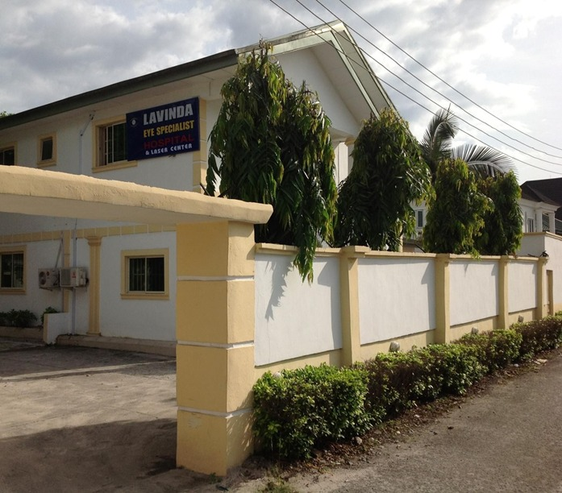
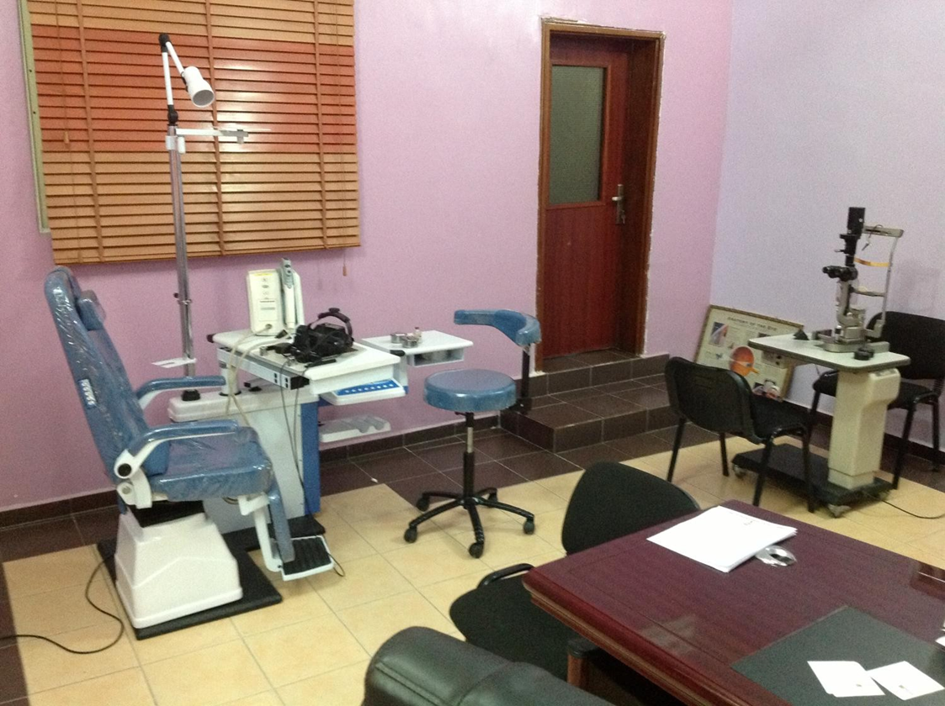
Introduction: Brief Project Recap
The client in this project is Lavinda Eye Specialist Hospital.
Formed in 2007 and located in Port Harcourt (Lavinda Eye Specialist Hospital, 2025)
It serves a large population in the area of ophthalmology.
Experience several bottlenecks like:
Delays in patient flow
Limited digital presence
Frequent equipment malfunctions
Budgetary constraints
These challenges impact the hospital's performance and competitive advantage.
Notes:
In this project, my client is Lavinda Eye Specialist Hospital, established in 2007 in Port Harcourt (Lavinda Eye Specialist Hospital, 2025). The hospital provides vital ophthalmology services to a large and growing population. Despite its importance, Lavinda faces key operational challenges that limit its effectiveness. These include delays in patient flow, frequent equipment malfunctions, limited digital presence, and budgetary constraints. Insights gathered through the staff survey revealed how these issues directly affect both performance and patient satisfaction. For example, slow patient flow and machine breakdowns have hurt the hospital's reputation and reduced patient trust. As such, there was a need to effectively address this challenges by designing reliable and attainable recommendations for Lavinda hospital.

Slide 3

Introduction: Brief Project Recap Cont.…
Objective of this consultancy project;
Assess the root causes of these issues
Recommend evidence-based, practical solutions that align with Lavinda's goals.
The final recommendations include:
Implementing a digital appointment and patient flow management system
Establishing a preventive maintenance protocol for equipment
Launching a hospital website and basic digital marketing strategy.
Notes:
The primary goal of consultancy project at Lavinda Eye Specialist Hospital was to assess the root causes of the hospital's operational challenges and recommend practical, evidence-based solutions aligned with its vision for growth. After thorough assessment and research, three critical recommendations were developed. First, the hospital should implement a digital appointment and patient flow management system to enhance efficiency and reduce waiting times. Second, the hospital should establish a preventive maintenance protocol for essential equipment to minimize service interruptions. Finally, the hospital should launching a hospital website coupled with a basic digital marketing strategy to increase visibility and attract more patients.

Slide 4
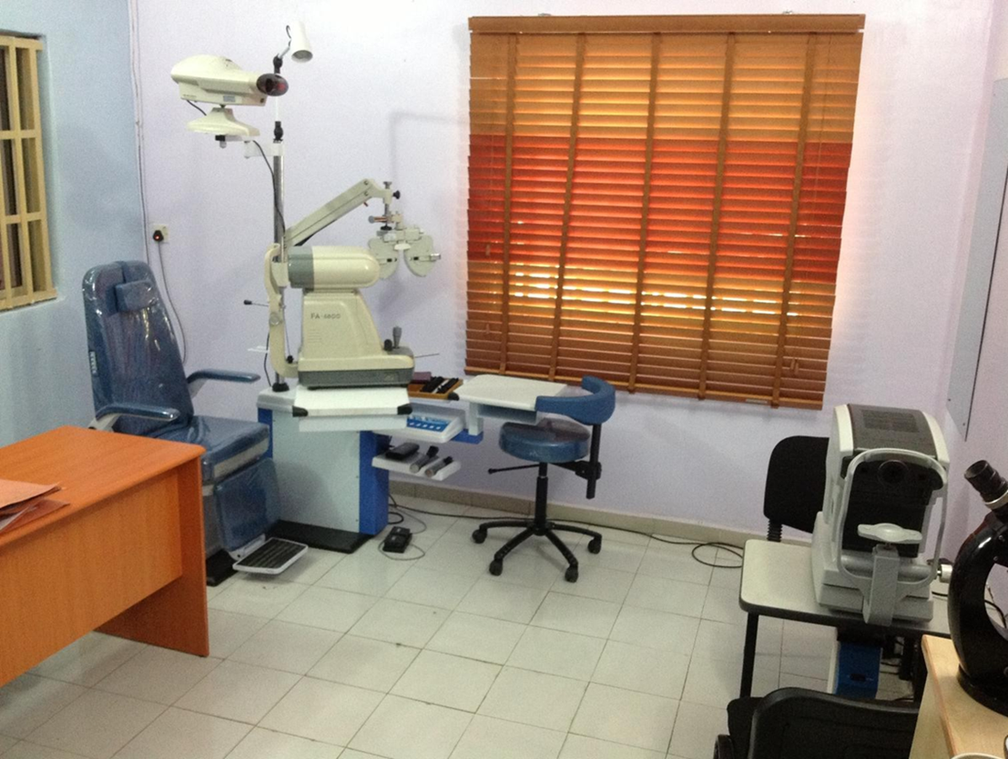
Agenda
Introduction
Recommendation
Change and Implementation Plan
Reflection
Conclusion/Next Steps
References
Notes:
This presentation is structured into three main sections. First, I will outline the final recommendations, supported by data-based analysis. The section will outline the expected benefits and impacts, along with a practical implementation plan tailored to Lavinda Eye Specialist Hospital. Second, I will reflect on the consultancy process, highlighting the challenges encountered and how they were addressed, the skills developed, and the key lessons learned throughout the project. I will also present the conclusion and next steps, providing a roadmap for how Lavinda can move forward effectively to achieve sustainable improvement. The final aspect will be documenting the references that were essential in this entire presentation.

Slide 5
Implement a digital appointment and patient flow management system
Manual appointing system establishes unnecessary delays and bottlenecks
Impacting the hospital's operations and service delivery
82% of respondent from primary survey linked appointment availability to increased delays, as shown in Fig. 1.
A digital appointment and patient flow management system will be essential for Lavinda Hospital.
Fig. 1: Factors causing delays or bottlenecks in Lavinda Hospital
Notes:
One of the most pressing challenges identified at Lavinda Eye Specialist Hospital is the manual appointment system, which creates significant delays and bottlenecks in patient flow. This issue slows down service delivery and negatively affects patient satisfaction and overall operational efficiency. From the staff survey conducted, nearly 82% of respondents directly associated appointment availability with increased delays, as highlighted in Figure 1. These findings demonstrate that scheduling inefficiencies are a core driver of patient flow challenges. Therefore, introducing a digital appointment and patient flow management system will be a vital step. This solution will streamline scheduling, reduce waiting times, and enable better resource allocation, ultimately improving both patient experience and hospital performance.

Slide 6

Benefits and Impacts of Implementing a digital appointment and patient flow management system
Digital systems like AI-based patient flow management improve patient flow.
They help Lavinda Hospital streamline its operations and service delivery.
For example, digital or AI interventions in Canada enhanced management of appointment scheduling (The National Centre for Biotechnology Information, n.d.).
Digital patient system recording reduce waiting time by nearly 54% (Montazeri et al., 2020)
Notes:
Implementing a digital appointment and patient flow management system at Lavinda Eye Specialist Hospital will deliver substantial benefits. Such systems, especially those enhanced by AI-based interventions, have been shown to optimise scheduling and ensure a smoother patient journey (Montazeri et al., 2020). By digitising and automating the process, Lavinda can significantly reduce waiting times, improve service delivery, and better align operations with patient demand. Evidence from Canada demonstrates that adopting digital and AI tools in healthcare has improved patient flow and appointment management, resulting in more efficient resource utilisation and higher patient satisfaction (National Centre for Biotechnology Information, n.d.). For Lavinda, these impacts would not only streamline operations but also build a reputation for reliability and efficiency.

Slide 7
Establish preventive maintenance protocols for equipment in addition to predictive maintenance.
Fig 1: Impacts of equipment delays or malfunctioning on Lavinda Hospital
The hospital experiences malfunctions or delays in equipment.
This leads to the cancellation of procedures and rescheduling chaos
100% respondents from primary survey findings in Fig. 2 linked equipment delay or malfunctions to rescheduling of patient appointments
Preventive maintenance protocols for equipment in addition to predictive maintenance will improve service delivery
Notes:
Lavinda Eye Specialist Hospital has faced recurring challenges with equipment such as laser and phacoemulsification machines, often resulting in delays, cancelled procedures, and rescheduling chaos. The survey findings, shown in Figure 2, revealed that 100% of respondents linked equipment delays or malfunctions to disrupted appointments, underscoring the severity of the problem. To address this, Lavinda should not only rely on predictive maintenance but also establish preventive maintenance protocols. Preventive maintenance ensures routine inspections and servicing, which reduces unexpected breakdowns and extends equipment life. Studies confirm that hospitals implementing both preventive and predictive maintenance experience improved reliability, reduced downtime, and enhanced continuity of patient care. This dual approach will safeguard service delivery at Lavinda.

Slide 8
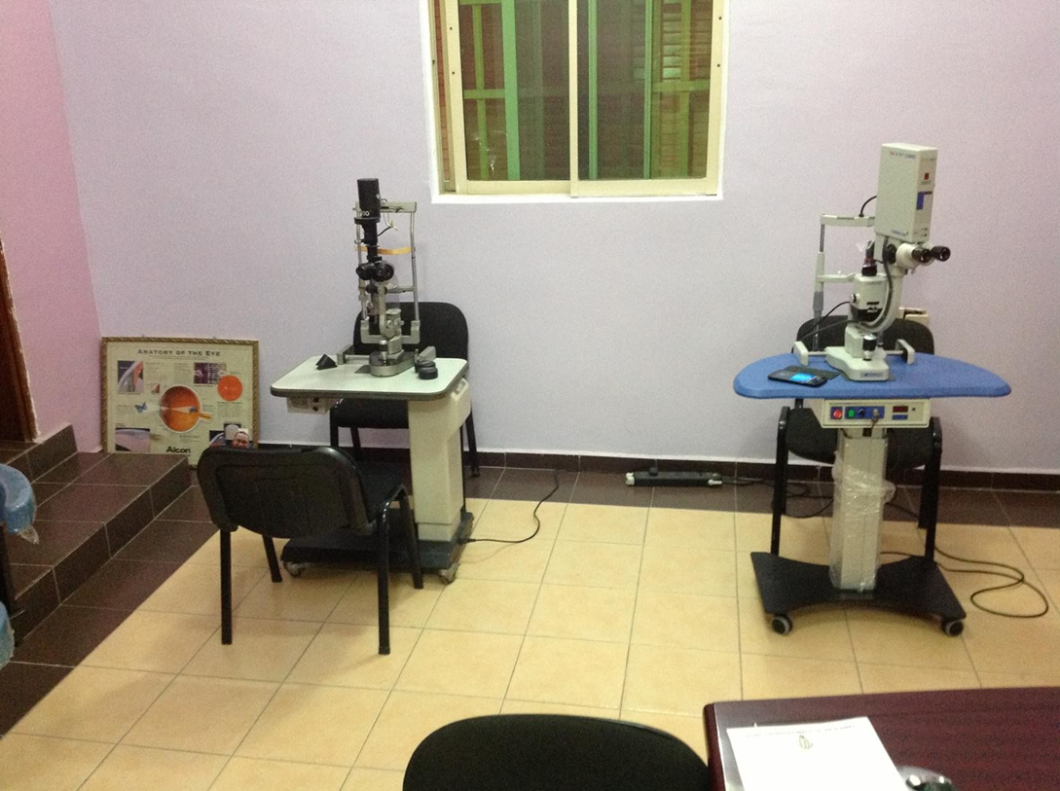
Benefits and Impacts of Establishing preventive maintenance protocols for equipment in addition to predictive maintenance
They are effective in lessening potential equipment failures.
They mitigates costs (Hardt et al., 2021; Hamasha et al., 2023)
They reduces costs by 12-18% and generates nearly 400% return on investment (Brightly, 2023)
They are essential for Lavinda Hospital to manage equipment delays or malfunctions.
Notes:
Establishing preventive maintenance protocols, alongside predictive maintenance, is a strategic step for Lavinda Hospital in addressing equipment-related delays and malfunctions. Research shows that both approaches are effective in reducing potential equipment failures and enhancing reliability in healthcare settings (Hardt et al., 2021; Hamasha et al., 2023). Preventive maintenance is particularly valuable in mitigating costs when the risk of failure is low, making it a cost-efficient strategy. Evidence suggests that preventive maintenance can reduce costs by 12–18% and deliver nearly 400% return on investment (Brightly, 2023). For Lavinda, this means not only minimising disruptions to patient care but also optimising resource allocation and operational efficiency. Implementing such protocols ensures continuous, high-quality service delivery and patient satisfaction.

Slide 9
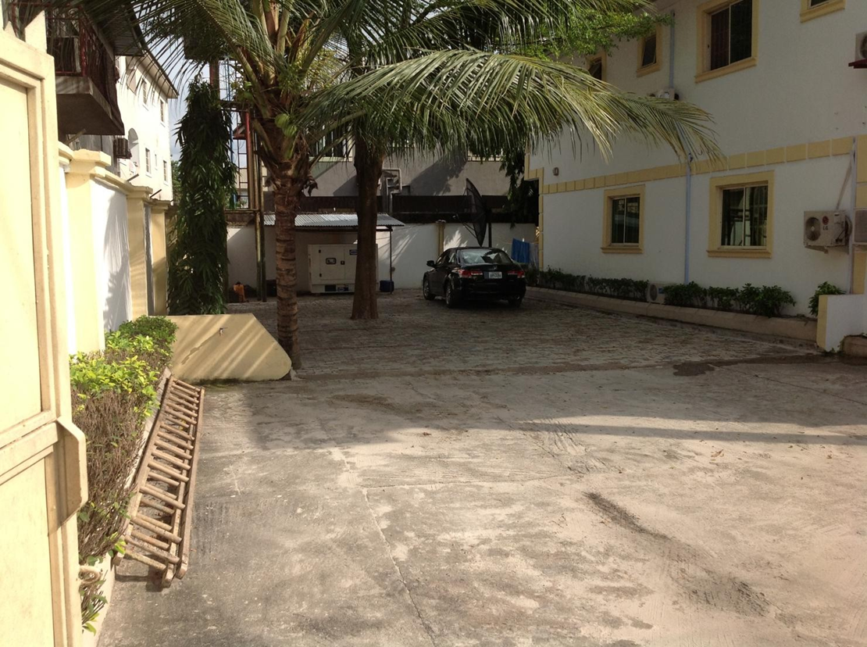
Launch a hospital website and basic digital marketing strategy.
Lavinda Hospital lacks an active website or digital presence
Manual practice, such as appointment scheduling, leads to delays
For example, 82% respondents in the primary survey in Figure 1 cited that delays result from appointment availability
The delays and absence of website challenges lessen patient engagement and trust
A hospital website and basic digital marketing strategies would be effective for the hospital.
Notes:
Lavinda Hospital currently operates without an active website or structured digital presence, which significantly limits its efficiency and patient engagement. However, the hospital relies heavily on manual appointment systems, which not only slow down service delivery but also frustrate patients. Our primary survey findings in Figure 1 revealed that 82% of respondents linked delays directly to appointment availability, underscoring this issue. The absence of a hospital website further reduces accessibility, transparency, and trust among patients. As such, launching a professional website and adopting a basic digital marketing strategy, Lavinda Hospital can streamline appointment booking, improve communication, and foster stronger patient relationships, ultimately enhancing overall service delivery and reputation.

Slide 10
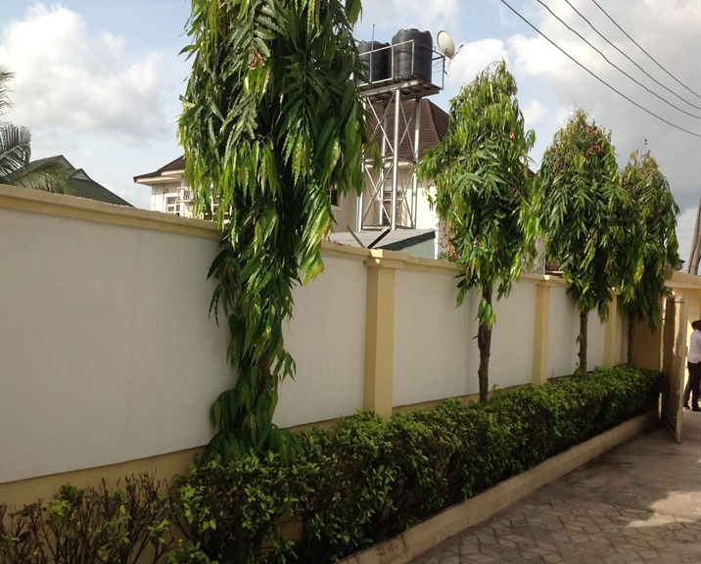
Benefits and Impacts of Launch a hospital website and basic digital marketing strategy.
Websites and digital enhance patients' trust and engagement.
Digital marketing promotes customer engagement, enhances brand, and ensures sustainability (Kamyabi et al., 2025)
Digital marketing on different platforms attracts customers and boosts their loyalty
65% of patients search online before appointment scheduling or contacting a doctor (Park, 2025)
91% of patients expect a response within 24hours, possible through website and digital marketing platforms (Park, 2025)
Notes:
Launching a hospital website combined with a structured digital marketing strategy will provide significant benefits for Lavinda Hospital. A strong digital presence is crucial for building patients' trust, engagement, and confidence in the hospital's services. Research highlights that digital marketing strengthens customer engagement, enhances brand image, and supports long-term sustainability (Kamyabi et al., 2025). By leveraging platforms such as social media, search engines, and email marketing, Lavinda can attract new patients while fostering loyalty among existing ones. The study by Park (2025) shows that nearly 65% of patients search online before booking an appointment or contacting a doctor, making a website essential for visibility. The study also depicts that 91% of patients expect responses within 24 hours, which can be effectively managed through online platforms.

Slide 11
Change and Implementation Plan
Task | Phased Timeline and Milestones | Responsible Stakeholders | Resources Required | Risk management
1. Establishing a preventive maintenance protocol for equipment | Phase 1 (Month 1-2): Evaluate the current tools and deterimine the gaps Phase 2 (month 3): identify and contract vendors Phase 3 (Month 4): establish protocols Phase 4 (month 5-6): staff training and launching protocol. | Hospital Management – Approves budget and oversees implementation Vendor Partners – Supply maintenance services and expertise Maintenance Team – Conducts inspections, documents gaps, and enforces protocols | Maintenance schedule tools, vendor contracts | Risk: Vendor delays Solution: Engage different vendors and set deadlines
Notes:
Establishing a preventive maintenance protocol for equipment focuses on minimizing equipment breakdowns through structured maintenance protocols. In Phase 1–2, we will assess existing equipment and identify gaps, followed by vendor selection in Phase 3. By Phase 4, protocols will be developed, documented, and staff trained for seamless adoption. Hospital Management, vendor partners, and the maintenance team will lead this initiative. Required resources include vendor contracts, tracking tools, and training materials. The key risk is vendor delays, mitigated by engaging multiple vendors early and setting strict SLAs. This plan ensures improved equipment uptime and operational reliability.

Slide 12
Change and Implementation Plan Cont…
Task | Phased Timeline and Milestones | Responsible Stakeholders | Resources Required | Risk management
2. Implementing a digital appointment and patient flow management system | Phase 1 (Month 1): Needs assessment and software Phase 2 (Month 2): Select software and customize workflow Phase 3 (Month 4): Pilot test with one department Phase 5 (Month 5): Train staff Phase 6 (Month 6): Full-scale rollout | IT Specialist – Leads software selection and integration Clinical Team – Provides workflow input and testing feedback Project Lead – Coordinates implementation and tracks milestones External Software Vendor – Customizes and supports the system | Almost $500 for a software, staff training materials. | Risk: Staff resistance Solution: Early training of staff and having feedback sessions
Notes:
The goal here is to improve patient flow, reduce wait times, and enhance service delivery through a digital appointment system. The implementation starts with Phase 1–2 which involves needs assessment, software selection, and customization. By Phase 3, we will pilot the system in one department, followed by staff training in Phase 5 and a full-scale rollout in Phase 6. Responsible stakeholders include the IT Specialist, Clinical Team, Project Lead, and an External Software Vendor. Resources required are software licenses, training modules, and IT support budgets. Risk includes staff resistance, mitigated by early orientation and continuous feedback. This system is expected to improve patient satisfaction and streamline operational efficiency.

Slide 13
Change and Implementation Plan Cont.…
Task | Phased Timeline and Milestones | Responsible Stakeholders | Resources Required | Risk management
3. Launching a hospital website and basic digital marketing strategy | Phase 1 (Month 1): Gather content and branding materials Phase 2 (Month 2): Website design & development Phase 3 (Month 3): Launch website Phase 4 (Month 4–6): Optimize content & SEO, launch social media | IT Specialist – Ensures website functionality and hosting Marketing Team – Develops content and oversees branding Consultancy Team – Provides SEO strategy and campaign optimization | Nearly $3000 for website design and development, SEO tools, and basic marketing content | Risk: delayed content approval Solution: recruit dedicates content approver
Notes:
Launching a hospital website and basic digital marketing strategy boosts the hospital’s digital presence and patient engagement. Phase 1–2 includes content gathering and website development. By Phase 3, the website will be launched, with Phase 4–6 dedicated to content optimization, SEO, and social media marketing. Key stakeholders include the IT Specialist, Marketing Team, and Consultancy Team. Resources involve website development funds, SEO tools, and a content creation team. The primary risk is delayed content approval, mitigated by assigning a dedicated approver and weekly progress checkpoints. This approach will enhance visibility, attract new patients, and support long-term growth.

Slide 14

Reflection: Challenges and Solutions
Challenge 1: Limited data
The hospital staff were reluctant to engage in the survey, citing time constraints
Solution
I decided to review the survey by making it shorter and focused on neutral closed-ended questions with a few open-ended questions.
Challenge 2: Limited client engagement
The hospital had no designated project liaison
The hospital lacked enough digital records, forcing me to concentrate on manual validation and follow-ups
I also considered effective coordination with administration and staff to access key information or data for the project
Making consultation difficult in maintaining consistent communication
Notes:
The slide presents the main challenges I faced during the project and the solutions applied. The first challenge was limited data collection. Hospital staff were reluctant to participate in the survey due to time constraints, and the lack of digital records forced reliance on manual validation and follow-ups. To address this, I shortened the study, focused on clear closed-ended questions, and maintained open-ended options for deeper insights. I also worked closely with hospital administration to gain access to essential data. The second challenge was limited client engagement, as there was no project liaison.

Slide 15
Reflection: Challenges and Solutions Cont.…
Solution
I addressed the issue by scheduling weekly check-ins through phone calls and emails with distinct departments, which assisted in keeping the project momentum and promoting clarity
Challenge 3: A strategic challenge
Stemming from the disparity between the scope of needs and available resources.
Solution
I conducted in-depth research into cost-effective and scalable alternatives, such as utilizing free website hosting services like GitHub, to enhance the development of the hospital&amp;apos;s website.
The hospital administration and several interviewed staff members noted budget constraints
This limited the feasibility of specific tech-based recommendations, such as developing a website.
Notes:
I overcame challenge 2 by organizing weekly check-ins via phone calls and emails with different departments, which improved communication, sustained project momentum, and promoted clarity. The third challenge was a strategic one, arising from the gap between the hospital's needs and its available resources. Budget constraints highlighted by administration and staff limited the feasibility of several technology-based recommendations, particularly the development of a fully functional website. To overcome this, I conducted deeper research into cost-effective and scalable options. The solution was to explore free hosting platforms such as GitHub, which offered a practical alternative without straining financial resources. This approach ensured that the hospital could still establish a digital presence at minimal cost while maintaining flexibility for future upgrades. Ultimately, the strategy balanced resource limitations with the need for modernization, making the recommendations more realistic and sustainable.

Slide 16
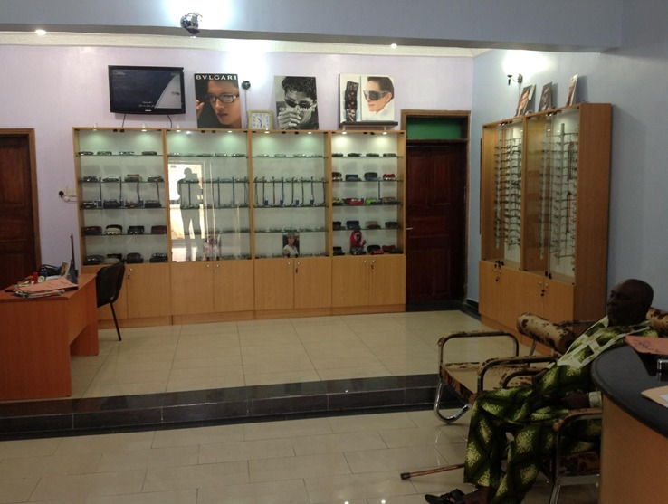
Skills Developed
Professional growth
I developed efficient websitedevelopmentskills which improvesmy capacity to develop strong and detailedwebsites
Personal growth
I gained effective knowledge of how communicate effectively with clients,which Iwill use in futurewhen interacting withmy consultancy clients.
I also got effective knowledge on datacollection and analysis skillswhich I will use in future projects
I gained more experience on how tonavigate real-world consultancy settings with tact, clarity, and adaptability
I also developed strong skills totranslate technical solutions into client-friendly language while managing expectations diplomatically, which I will use in future projects.
I acquired strong primary research technique/skills, which I will always use to improve my surveys practices in time-constrained healthcare settings
Notes:
The consultancy project offered a valuable opportunity for professional and personal development. On the professional side, I enhanced my website development skills, which proved crucial in providing practical, technology-based solutions. I also deepened my knowledge of conducting primary research within a time-constrained healthcare environment, which improved my adaptability. Also, I advanced my data collection and analysis skills and refined my time management abilities, ensuring tasks were completed within strict deadlines. In terms of personal growth, I improved my communication skills by engaging effectively with a consultancy client. I also strengthened my ability to navigate real-world consultancy settings with tact and adaptability, while sharpening my skills in translating technical recommendations into clear, client-friendly solutions that managed expectations realistically.

Slide 17
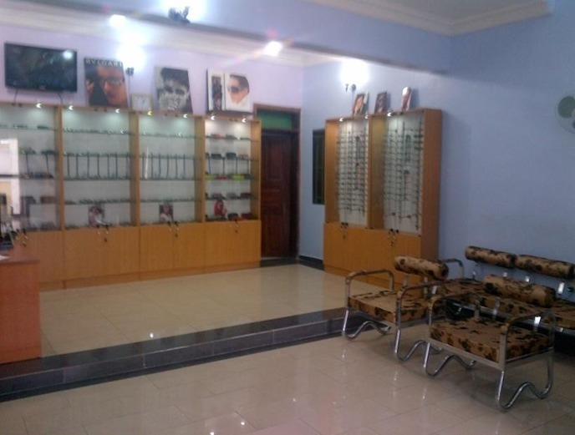
Key lessons learned
Lesson 1
Relationship building in consultancy
I learned that it is essential to build strong relationship with clients during consultancy project
Lesson 2
Simplicity in consultancy projects
I learned simplicity is relevant in consultancy project in resource-limited and low-tech settings
Lesson 3
Adaptability in Consultancy project
I learned that adaption is vital in consultancy
This will help me in future consultancy project to build trust with client and enhanced data collection process
It help in developing solution that seem ideal in theory to the clients’ realities
The relationship is built through listen attentively, show genuine interest, and respect clients’ time.
With simplicity, I will be able to develop simple solutions that the organization can grasp with little resistance in my future constancy projects
Notes:
The project was informative and had various key lessons that shaped my professional outlook. First, relationship building is vital in consultancy; listening attentively, showing genuine interest, and respecting clients’ time builds trust and makes it easier to collect accurate and meaningful data. Second, I learned that simplicity is crucial, particularly in resource-limited settings. Proposing low-tech, incremental solutions ensures that organizations can adopt them with minimal resistance. Third, I discovered the importance of adaptability; some solutions that appear ideal in theory may not be feasible in practice, so adjusting recommendations to fit client realities is essential. The challenges in Lavinda Hospital also taught me to think creatively within limits, ensuring that solutions remain practical while still addressing critical needs.

Slide 18
Conclusion and Next Step
The consultancy project focused on the assessment of Lavinda Eye Specialist Hospital's challenges.
This resulted in the development of practical solutions to promote the hospital's operations and service delivery.
The key recommendations include;
Establishing preventive maintenance protocols for equipment
Implementing a digital appointment and patient flow management system
Launching a hospital website and basic digital marketing strategy.
Success will be measured by:
Improved patient satisfaction scores r
Reduced appointment rescheduling rates.
Increased operational efficiency through better equipment uptime and smoother patient flow.
Enhanced financial performance, reflected in higher patient volumes and reduced procedure cancellations.
Notes:
The consultancy project focused on assessing the key challenges faced by Lavinda Eye Specialist Hospital and providing tailored solutions to address them. The findings highlighted issues around equipment reliability, patient flow management, and limited digital presence. To address these challenges, I recommended the establishment of preventive maintenance protocols to reduce downtime and improve efficiency, alongside a digital appointment and patient flow management system to streamline service delivery. Also, the recommendation to launch a hospital website and implement a basic digital marketing strategy will enhance visibility, strengthen patient trust, and position Lavinda more competitively in the healthcare sector. Lavinda Hospital’s success through these practical, cost-effective solutions will be determined by measuring patient satisfaction scores, reduced appointment rescheduling rate, increased operational efficiency, and heightened financial performance.

Slide 19
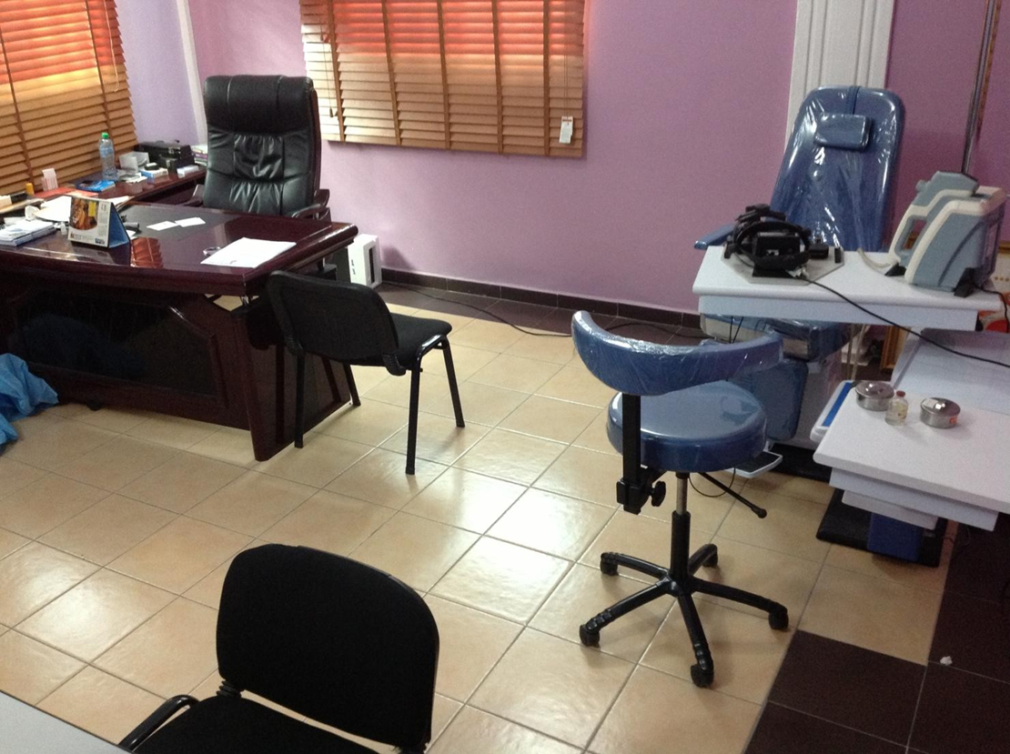
Next Steps
The following steps for Lavinda Eye Hospital:
Prioritize the launch of the website and digital platforms
Partnering with local vendors for equipment servicing
Establish the internal implementation team to oversee execution
My next step will also include:
Using the skills gained in future consultancy or project management roles
I plan to improve my knowledge in implementation science and low-cost tech innovations
Notes:
The next steps for Lavinda Eye Hospital focus on turning the proposed solutions into actionable outcomes. First, the hospital should prioritize the launch of its website and digital platforms, as this will immediately improve visibility and patient engagement. Second, partnering with local vendors for equipment servicing will ensure reliable maintenance and minimize downtime. Third, an internal implementation team should be established to oversee the roll-out, ensuring accountability and progress tracking. My next step is to apply the skills I’ve gained, particularly in consultancy, project management, and client engagement, in future roles. Additionally, I plan to expand my expertise in implementation science and low-cost technological innovations to provide even more impactful solutions in similar contexts. Generally, the focus on these next steps will ensure Lavinda Eye Hospital experiences measurable improvements in patient care and operational efficiency and ensure consultancy journey has strengthened my ability to deliver impactful, practical, and sustainable solutions in real-world healthcare settings.

Slide 20
General Conclusion
The recommendation will help Lavinda Eye Hospital:
Experiences measurable improvements in patient care
Operational efficiency and ensure consultancy journey
The consultancy project will strengthen my ability to deliver impactful, practical, and sustainable solutions in real-world healthcare settings.
Notes:
Generally, the focus on the final recommendation will ensure Lavinda Eye Hospital experiences measurable improvements in patient care and operational efficiency. Also, the consultancy journey has strengthened my ability to deliver impactful, practical, and sustainable solutions in real-world healthcare settings.

Slide 21
References
Brightly. (2023, August 21). The ROI of preventive maintenance: Is it really worth it? https://www.brightlysoftware.com/learning-center/ROI-preventive-maintenance#
Hamasha, M. M., Bani-Irshid, A. H., Al Mashaqbeh, S., Shwaheen, G., Al Qadri, L., Shbool, M., ... and Al-Bashir, A. (2023). Strategical selection of maintenance type under different conditions. Scientific Reports, 13(1), 15560. https://doi.org/10.1038/s41598-023-42751-5
Hardt, F., Kotyrba, M., Volna, E., and Jarusek, R. (2021). Innovative approach to preventive maintenance of production equipment based on a modified tpm methodology for industry 4.0. Applied Sciences, 11(15), 6953. https://doi.org/10.3390/app11156953
Kamyabi, M., Özgit, H., and Ahmed, J. N. (2025). Sustaining Digital Marketing Strategies to Enhance Customer Engagement and Brand Promotion: Position as a Moderator. Sustainability, 17(7), 3270. https://doi.org/10.3390/su17073270
Lavinda Eye Specialist Hospital (2025) Corporate Profile. Port Harcourt, Nigeria. Available at: www.lavindaeyehospital.com/corporate-profile (Accessed: 13 March 2025).
Montazeri, M., Multmeier, J., Novorol, C., Upadhyay, S., Wicks, P., and Gilbert, S. (2020). The potential for digital patient symptom recording through symptom assessment applications to optimize patient flow and reduce waiting times in Urgent Care Centers: a simulation study. medRxiv, 2020-06. https://doi.org/10.1101/2020.06.19.20135590
National Center for Biotechnology Information. (n.d.). Artificial intelligence for patient flow - NCBI bookshelf. https://www.ncbi.nlm.nih.gov/books/NBK604824/
Park, J. (2025). All 37 healthcare marketing statistics that drive results in 2025. Digital Silk. https://www.digitalsilk.com/digital-trends/healthcare-marketing-statistics/

